Slide 1

Accessing GPT-4 level Mathematical Olympiad Solutions via Monte Carlo Tree Self-refine with LLaMa-3 8B
ConvAI Reading Group #1
Sumuk Shashidhar
August 29th, 2024

Slide 2

Caveats
I’ll spend some time talking about why this is a good problem, before I start presenting the paper! 🧐
This talk is laden with my personal opinions and ideas, not indicative of the authors’ stance. 😊
There are graphs, figures, and numbers that are not found in the original paper. 😯

Slide 3
Contents
Introduction: What is this?
Why does it make sense to deploy small models?
What is the General Intuition?
Does this work in practice?
Paper Methodology: What did they do?
Monte Carlo Tree Search
Monte Carlo Tree Search Self Refine
Don’t models like their own outputs?
Closing Thoughts: What you can do!
Limitations
Future Work!

Slide 4
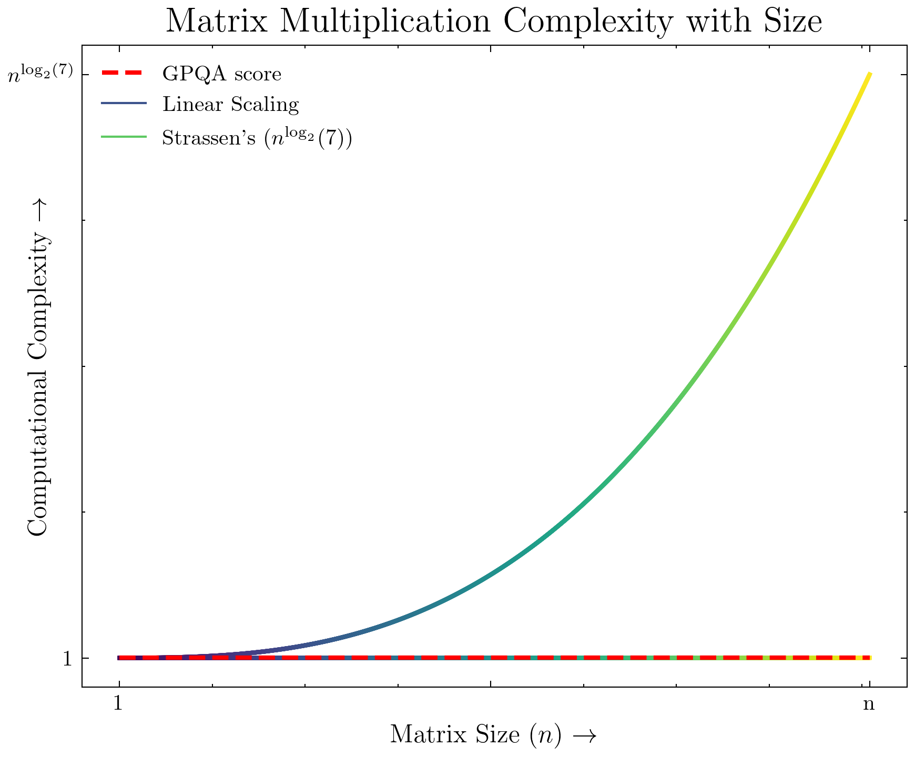
Why does it make sense to deploy small models?
LLM inference is matrix multiplication.
Matrix multiplication complexity: O(n^{2.807}) via Strassen’s algorithm. [1]
Consequence: Bigger models require exponentially greater amounts of compute to perform.
However, capabilities are not exponential. They’re mostly linear. (e.g., GPQA)
Smaller GPUs (L4, 4090) are also much cheaper to manufacture, than larger GPUs (H100).
[1] Strassen, Volker. “Gaussian elimination is not optimal.” Numerische Mathematik 13 (1969): 354-356.

Slide 5
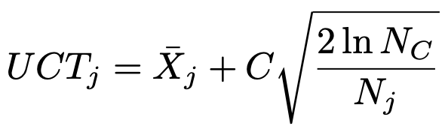
What is the General Intuition?
All intelligent life on earth makes good decisions by repeated [action, evaluation, reflection] triples.
We can use this process with models to elicit better answers.

Slide 6
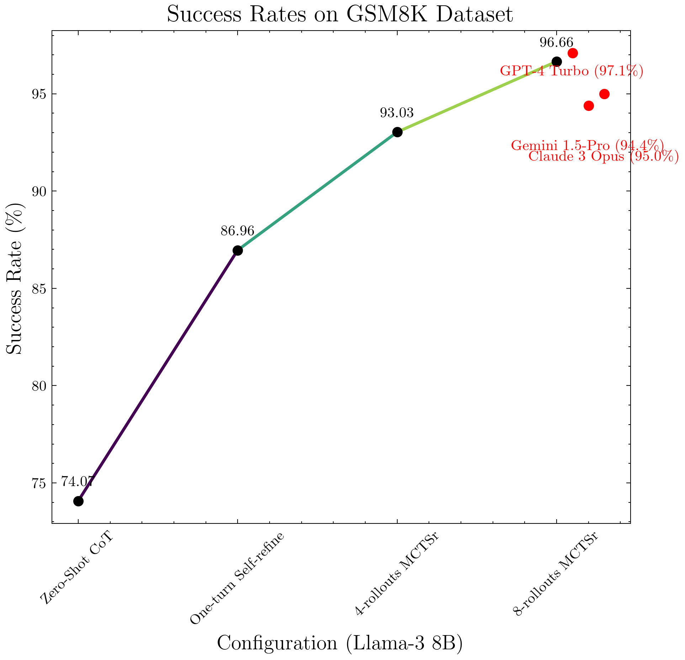
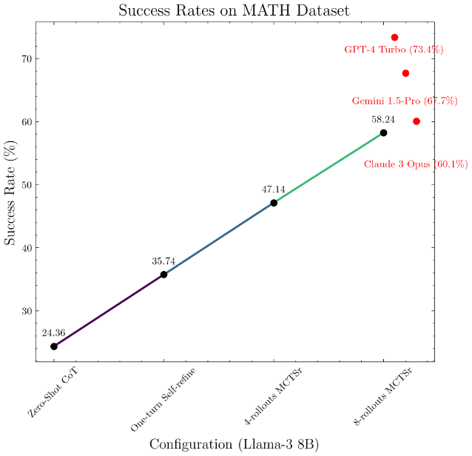
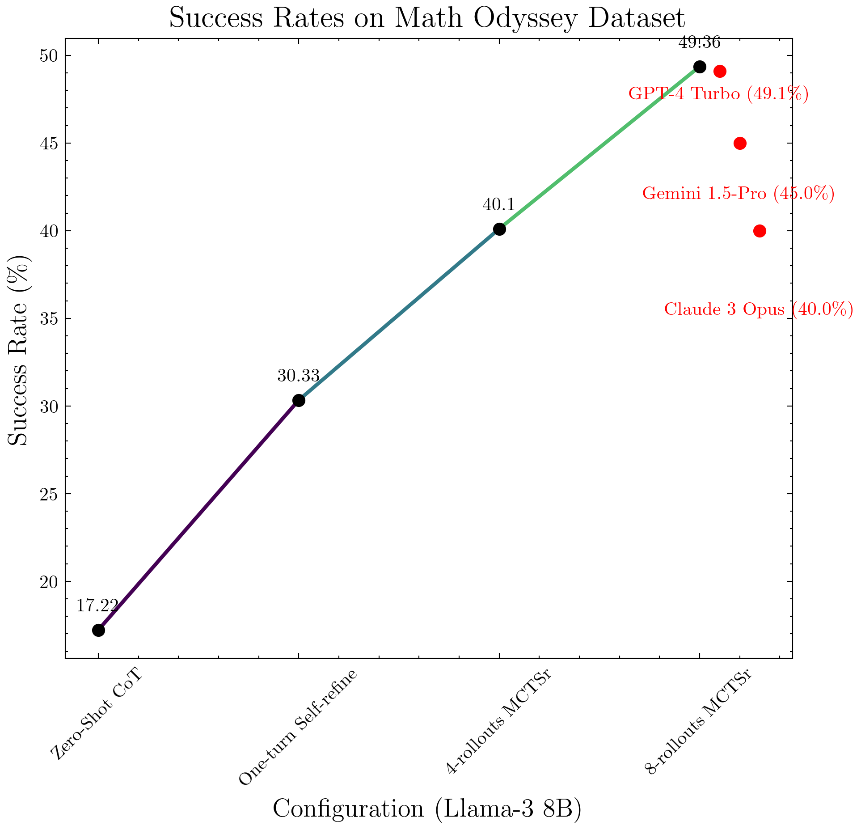
Does this work?
 | Llama 3 8B | Llama 3 8B Monte Carlo | GPT-4 Turbo
GSM8K | 74.1 | 96.6 | 97.1
MATH | 24.36 | 58.24 | 73.4
Math Odyssey | 17.2 | 49.36 | 49.1
Yes!
Here are some interesting results

Slide 7
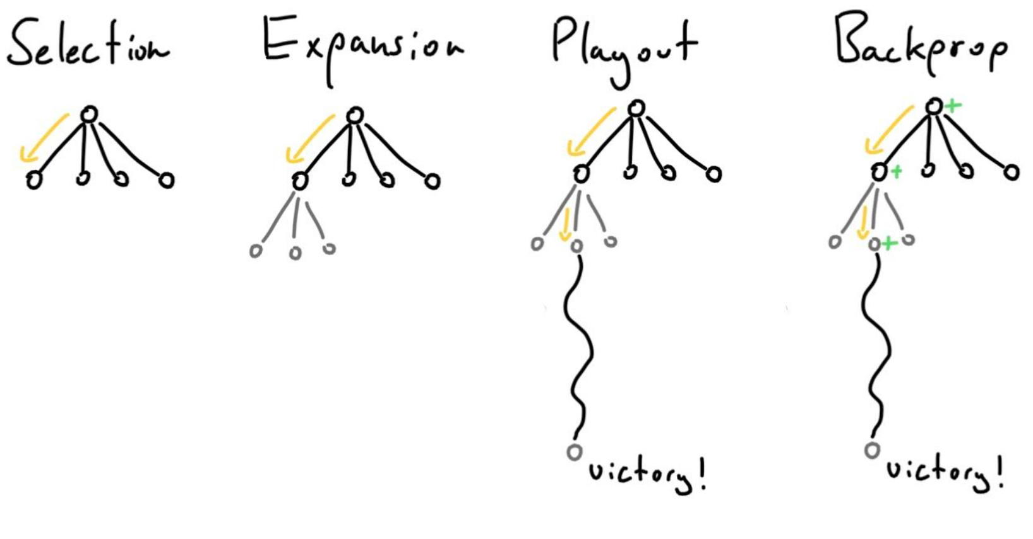

Monte Carlo Tree Search
Selection
Choose the most promising node / nodes
Expansion
Add one or more child nodes
Playout
Simulate a random playthrough
Backprop
Update the results
Used in the real world to great success (AlphaGo)!
Exploit
Explore

Slide 8
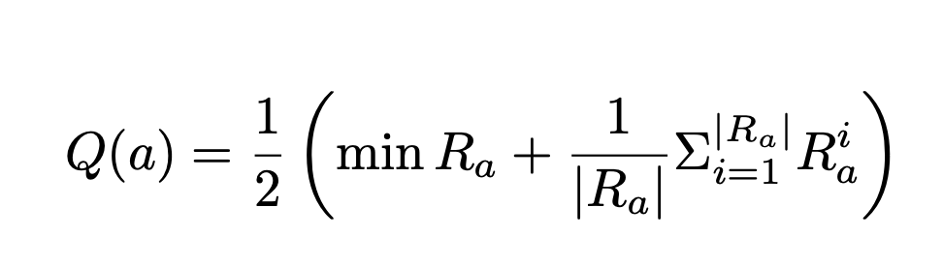
Monte Carlo Tree Search Self Refine (MCTSr)
There are some changes proposed, over the regular MCTS methodology
UCT Modification:
Purpose: Counteract the tendency of the self reward function.
Averages the Reward minimum and the mean, balancing worst case and average outcomes.
Dynamic Pruning:
Purpose: Limit Search Space
Stop if we reach a maximum number of child nodes.
At least one child node has a higher score than the parent.
Non-Random Rollout
Purpose: Converge to an answer quicker
Not random, does more a traditional search, generating new answers.
Here’s a short demo about how this works! →

Slide 9
Monte Carlo Tree Search Illustration
What is 2 + 2 + 2?
I don’t know
4 + 2
5
6
6 + 0
Start with a baseline answer.
Sample different answers.
Evaluate sampled answers. Score with the worst case with new Q function.
Propagate and re-explore. Stop exploring parent nodes if child nodes have higher score (Efficiency)

Slide 10
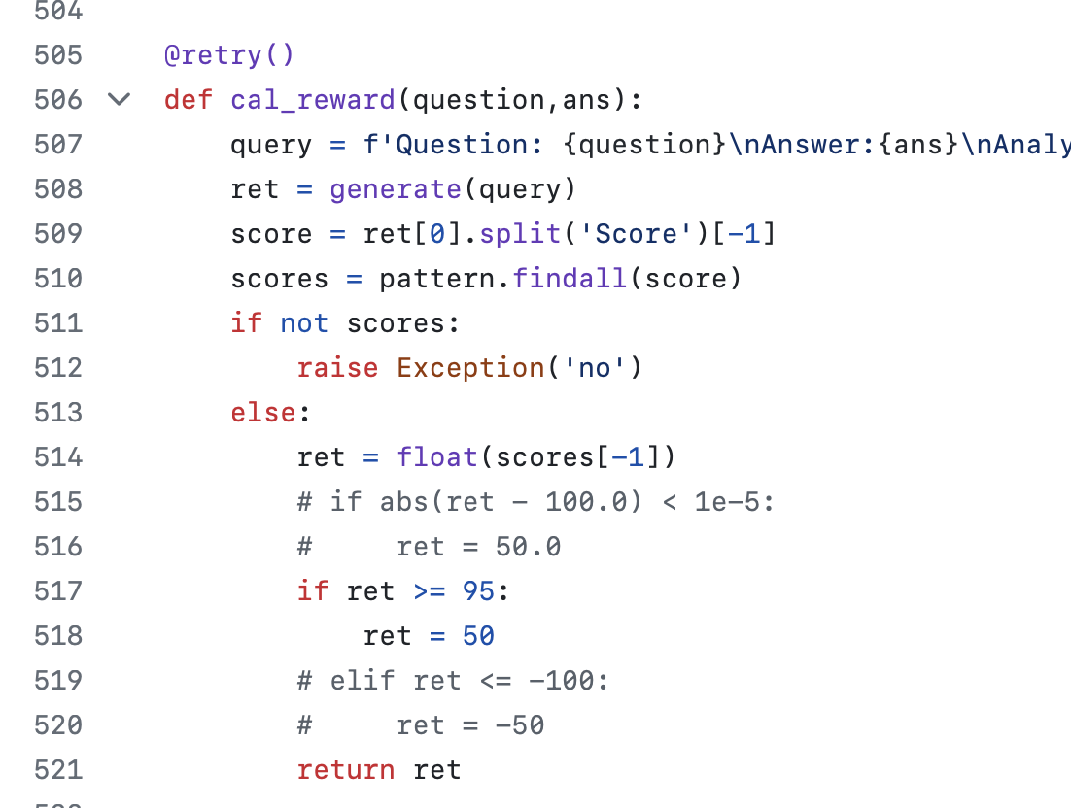
Don’t models like their own outputs? Doesn’t Self-Refine Overfit?
The paper proposes three mitigations:
Starting with a neutral answer. e.g., “I don’t know” or “I can’t answer that”.
Helps against overfitting
Hard cap scores at 95, when asking it to evaluate from (-100, 100)
Sample evaluations multiple times, then average.
How do we know that we’re not just retrieving more information from a contaminated benchmark?
Math Odyssey was released April 2024, after the release of Llama-3 and other models. Contains new questions.

Slide 11
Limitations
Technique Limitations:
Slow.
Expensive.
Unreliable.
Paper Limitations:
Lack of result discussion.
Where does MCTS not work? Where does it work? Example cases?
Why do the different datasets vary so much?
Overlap analysis: i.e., are there problems that GPT-4 gets right that MCTS doesn’t, and why?
Descriptions are too abstract about implementation.
Why did they not choose more rollouts? Is there a plateau?

Slide 12
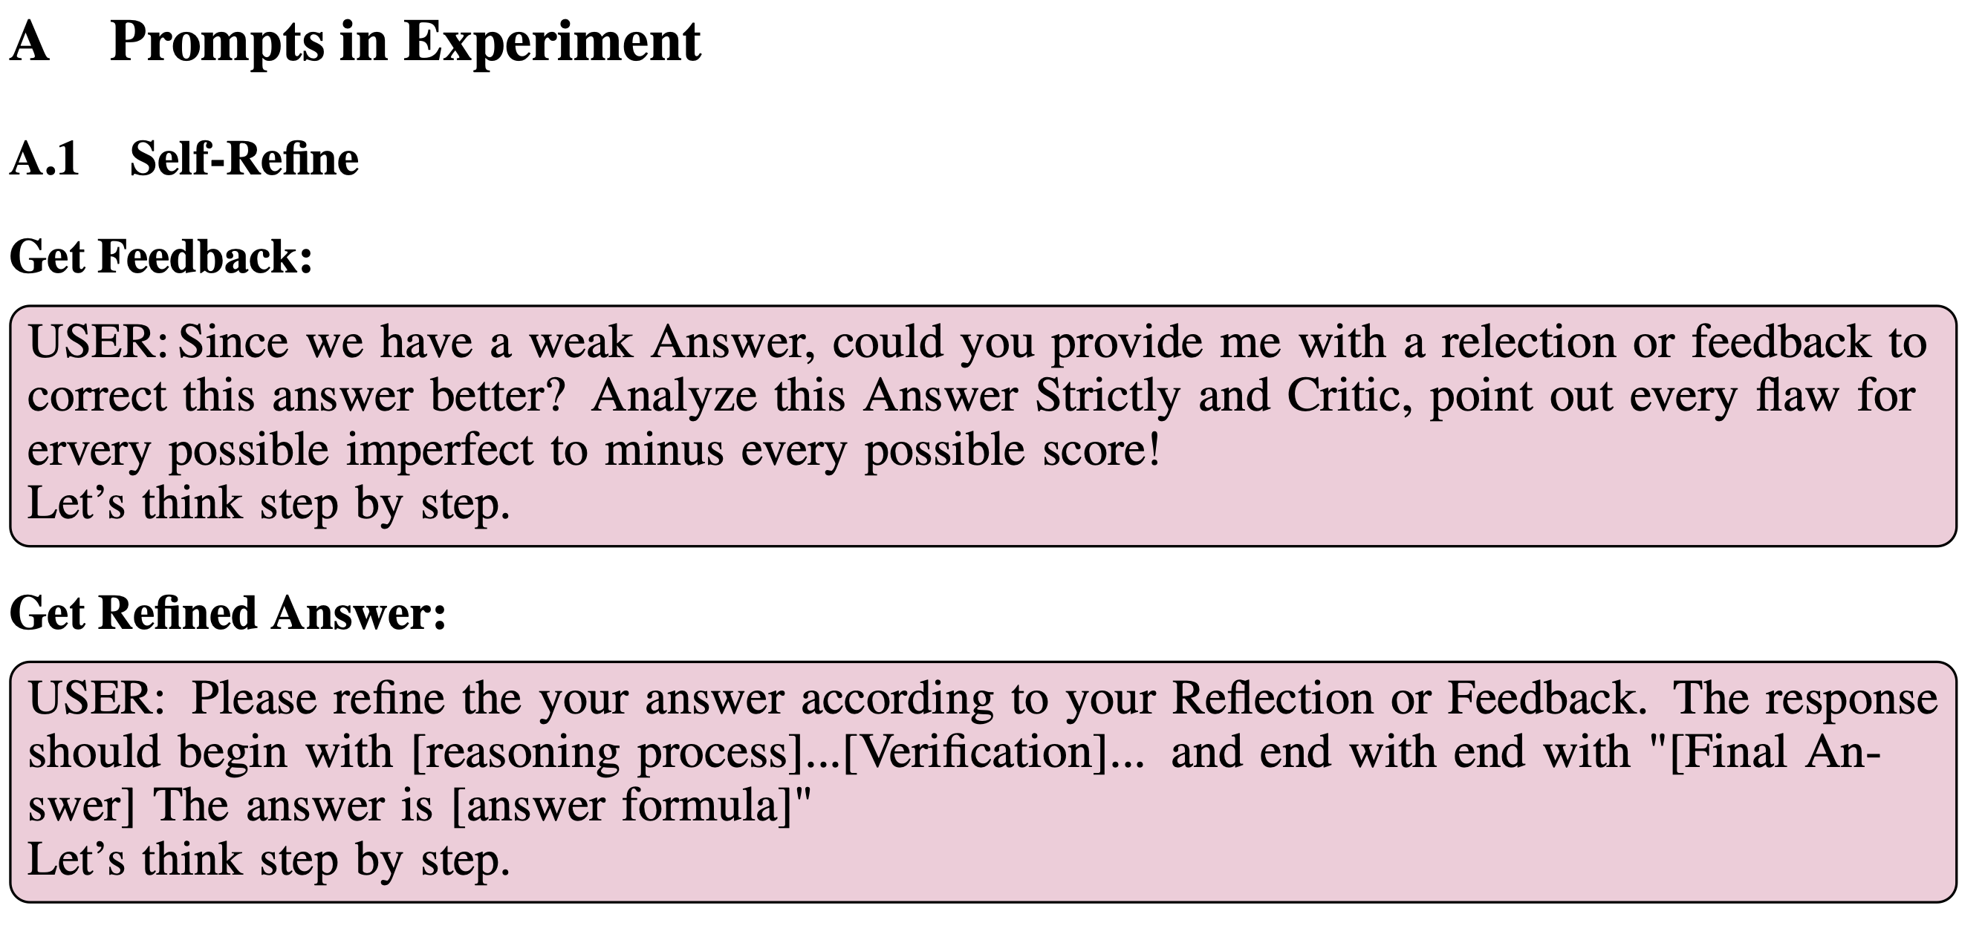
Future Work
Prompts in the paper are extremely under optimized!
Only math datasets have been tested, what about general decision making?
No discussion about plateau or degradation after multiple rollouts.

